Slide 1
CAR POOL
- Contributors
Pooja Mane
Sriharsha Makineni

Slide 2
CAR POOL
Details -
GitHub Repository: https://github.com/mpooja1/Car-Pooling
Licence: “MIT License”
Contact Information: Pooja - pooja.mane22@gmail.com Sriharsha - sriharsha004@gmail.com

Slide 3
CAR POOL
Current Functionalities developed
User Sign-in / Register
Update Personal Information
Offer ride to destination
Book ride to specific destination
Sending ride information through email
Future Enhancement
Add maps functionality
Get real time vehicle data for paid/free service
Integrate with a Payment gateway service
Introduce reward points to increase the number of customers

Slide 4
CAR POOL
Decisions
Success-
Learnt Android app development using Android Studio.
Learnt using Kinvey mBaaS and writing Business Logics.
Learnt new functionality of sending e-mails by developing the Business Logic on JSON data units in Kinvey.
Failures-
Setting a live GPS using Google Maps API.
Struggles-
Finding online backend database to manage data used by application.
Developing Maps Functionality.

Slide 5
CAR POOL
Lessons Learnt
Using Github
Using Android studio for creating app
Use of Google API Services while developing app
Google Maps on emulator
Database Integration using Kinvey (OpenSource mBaaS)
Developing Business Logics on data units which are stored as data objects using a JSON representation in the backend.

Slide 6
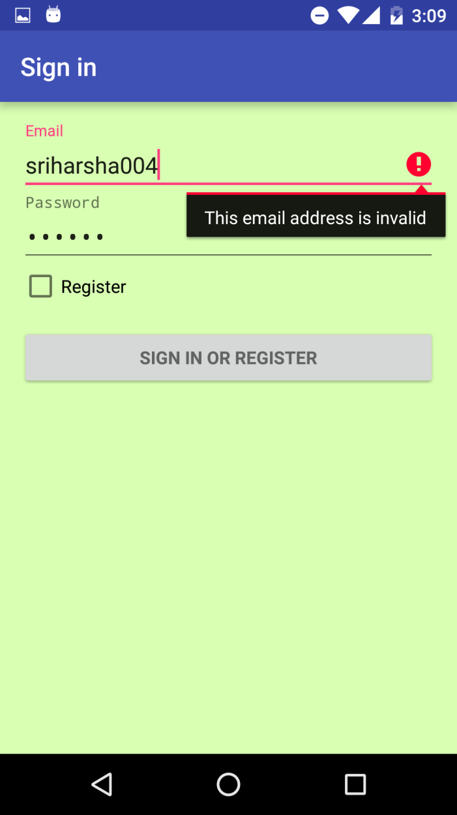
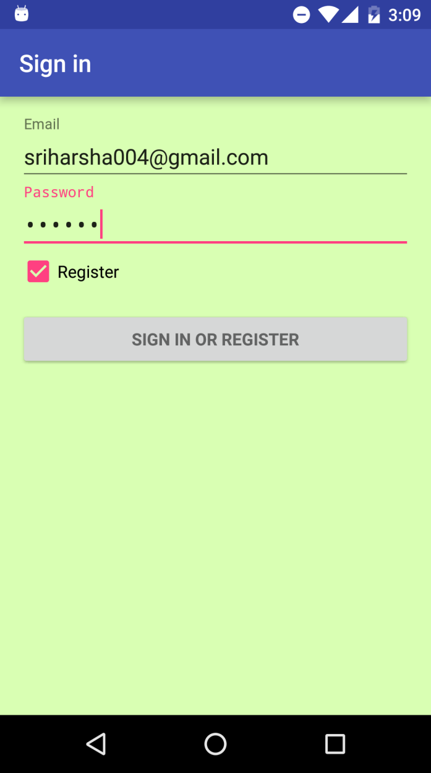
CAR POOL
User email validation
User Registration

Slide 7
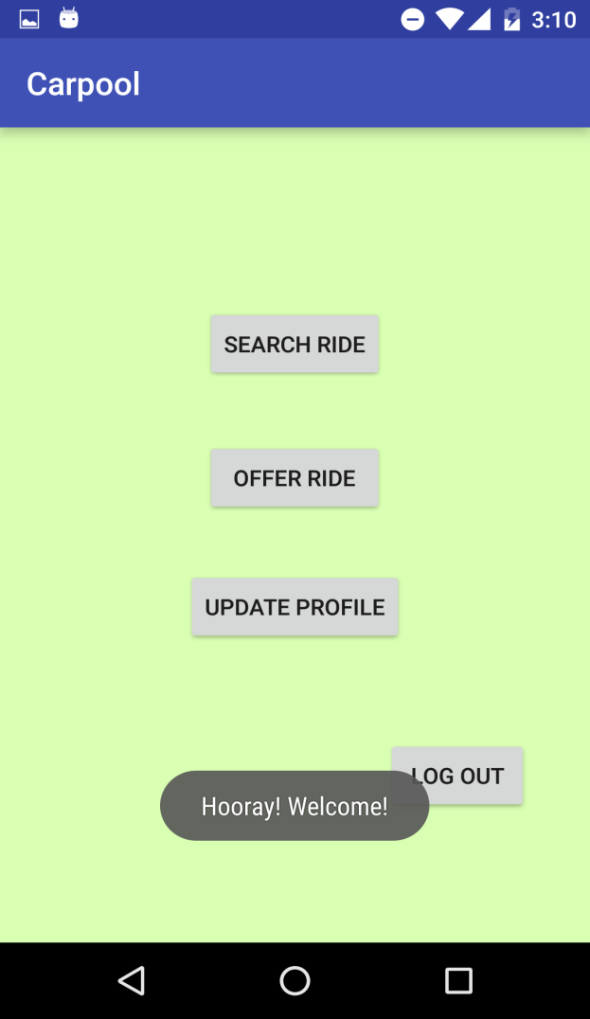
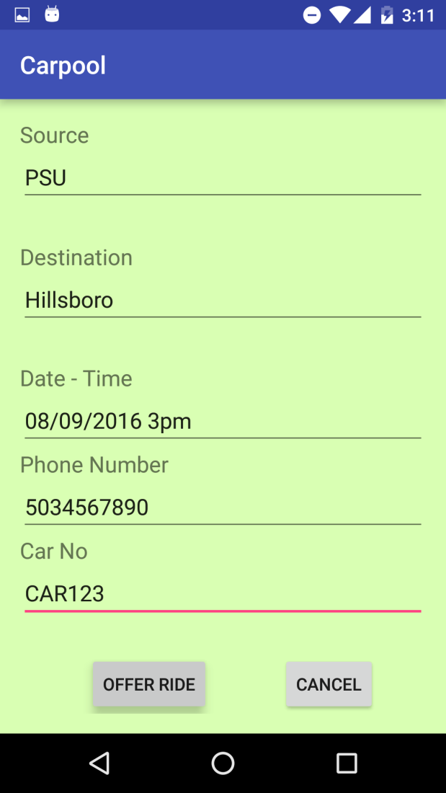
CAR POOL
Home Screen
Offer Ride activity

Slide 8
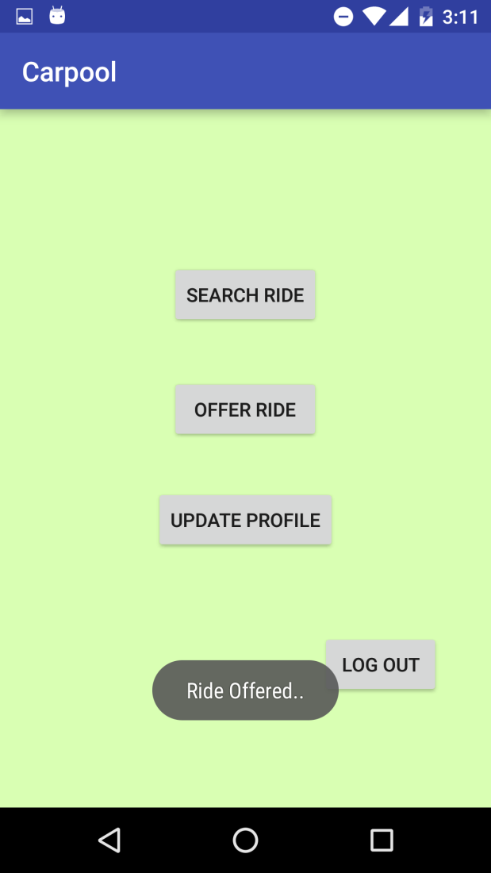
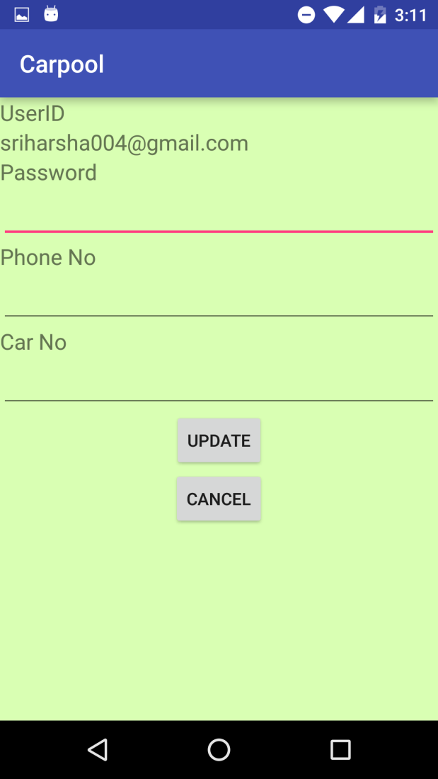
CAR POOL
Home Screen
Update Profile activity

Slide 9

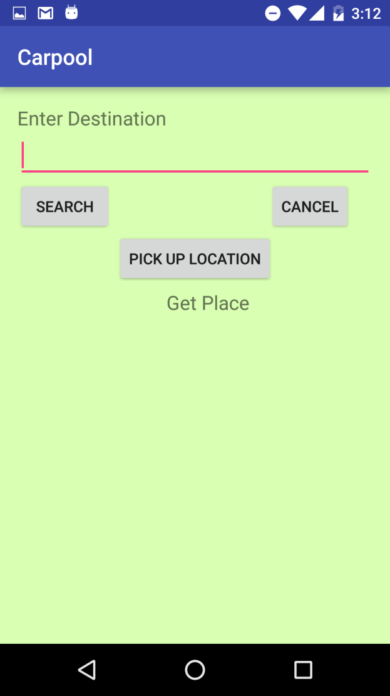
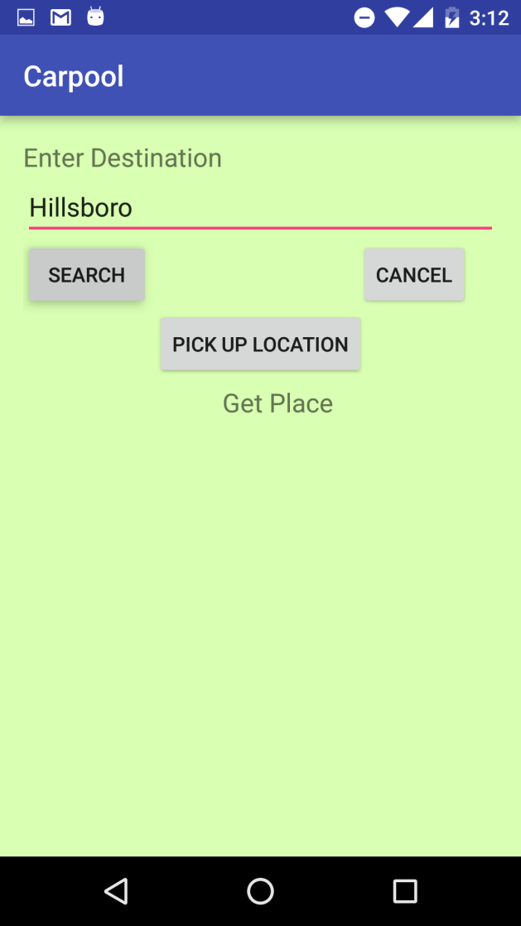
CAR POOL
Home Screen
Search Ride Activity
Search Ride Activity

Slide 10
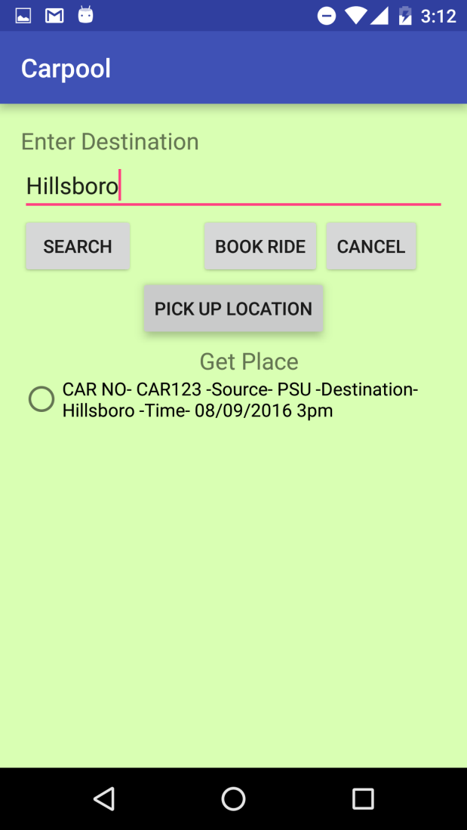
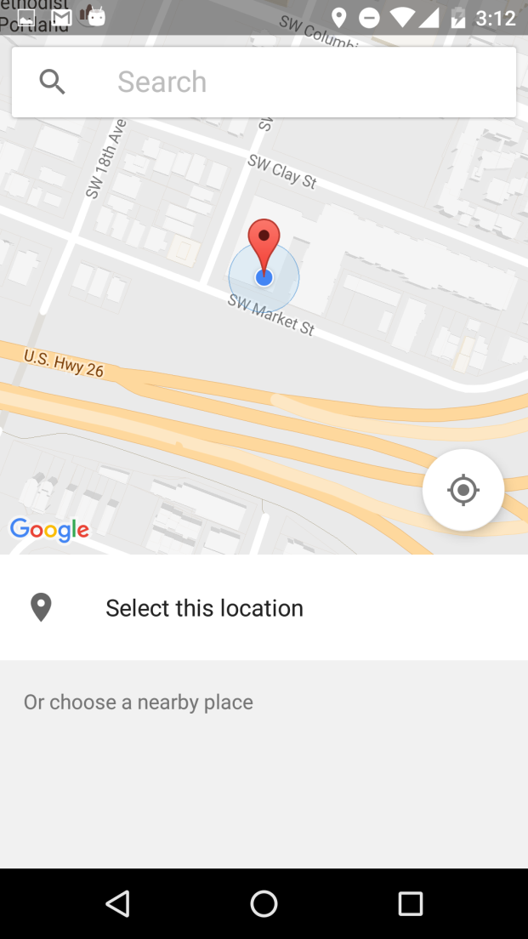
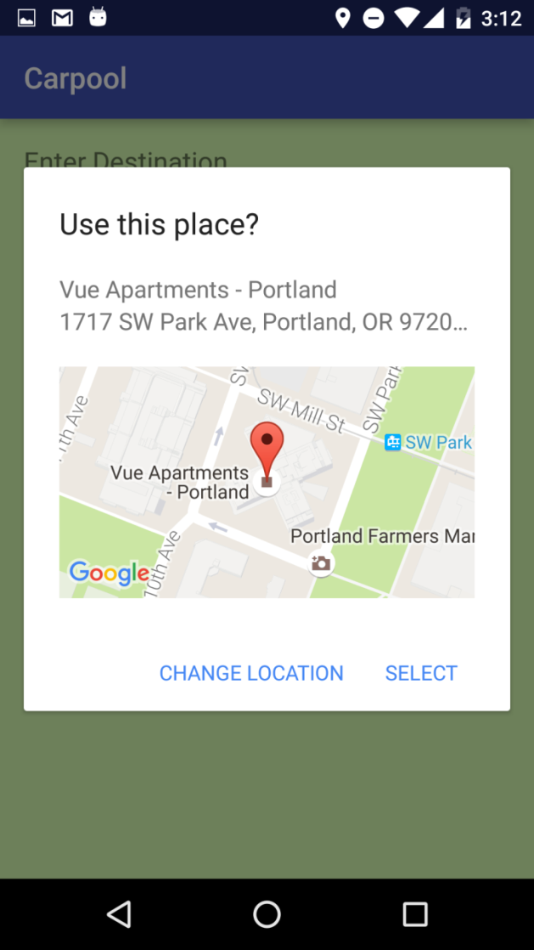
CAR POOL
Available Rides
Search location
Confirm location

Slide 11
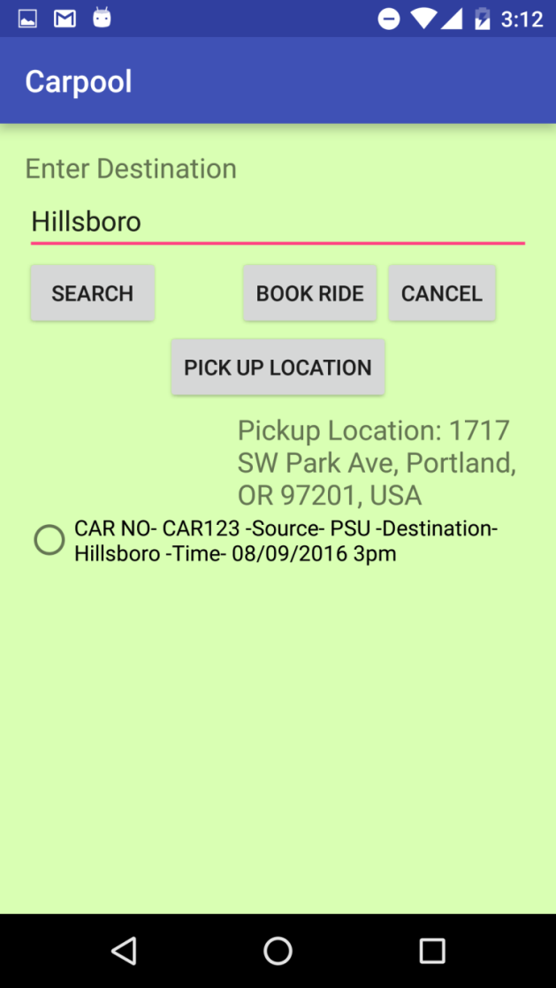
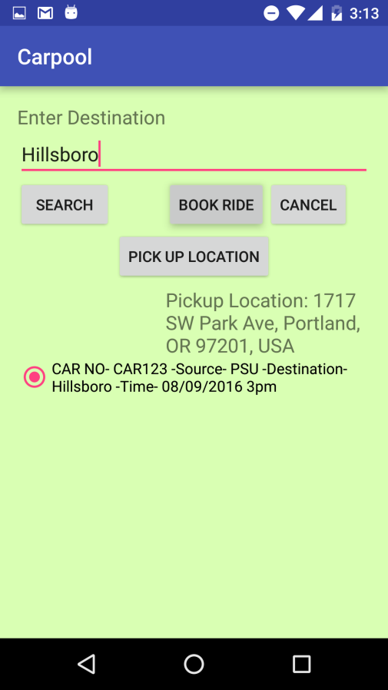
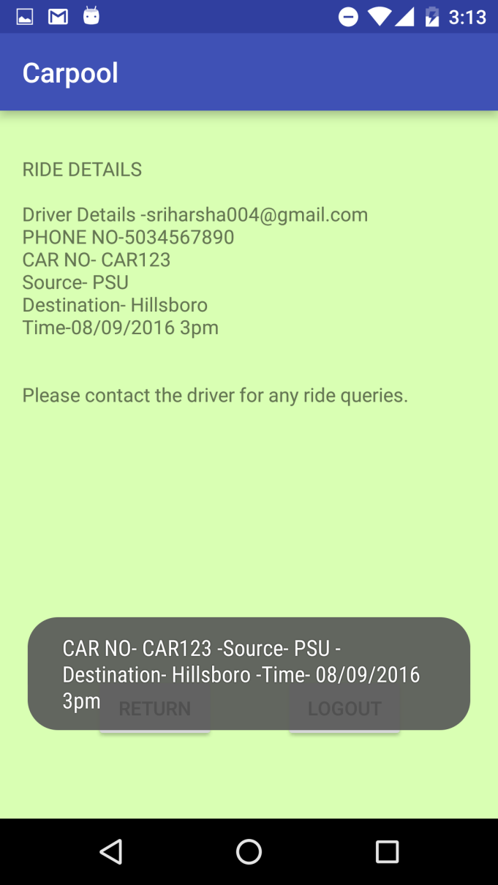
CAR POOL
Ride Selection
Ride Selection
Ride booked

Slide 12
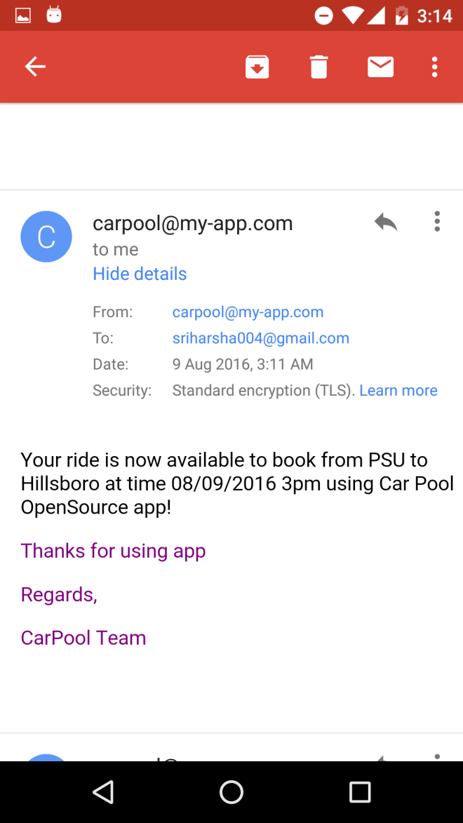
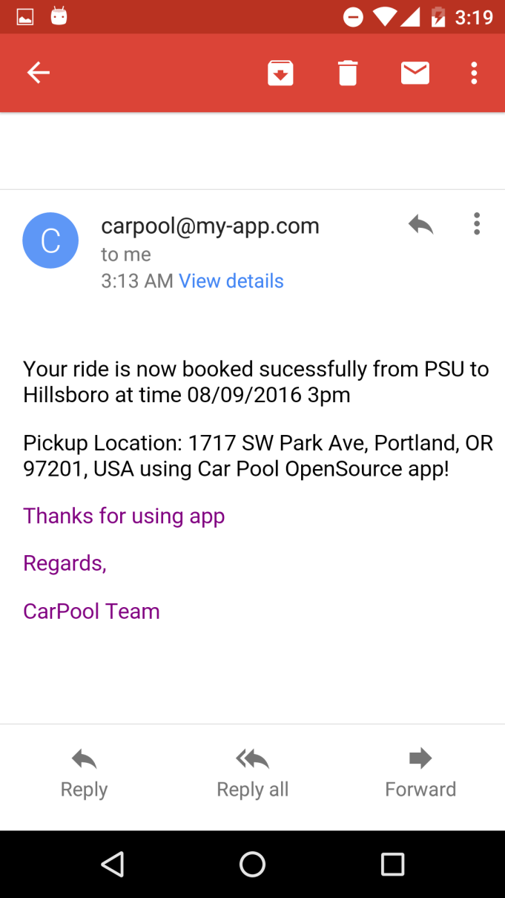
CAR POOL
Email after offering ride
Email after booking the ride

Slide 13
THANK YOU…!

